Slide 2
Agenda
Conditional statements
Use of Boolean operators
Shorthand notations if, elif, else
Ternary operators
For loops
Break
Continue
Range
While loops
Break
Continue
Program development

Slide 3
Conditional Statements

Slide 4
Logical operators from mathematics
EQUALS
a == b
NOT EQUALS
a != b
LESS THAN
a < b
LESS THAN OR EQUALS
a <= b
GREATER THAN
a > b
GREATER THAN

Slide 5

Use case: Sort the boxes
Suppose we have some boxes of different colors and weights
We want to identify and sort these boxes.

Slide 6
Use of logical conditions
The logical operators can be used in several ways
Most commonly they are used in conditional statements and loops.
Examples: In English
If color of a box is red AND weight of box is greater than 10kg
Then Do something…….
If (color of box is blue OR weight of box is less than 50kg) AND (color of box is red OR weight of box is less than-equals to 10kg)
Then Do something

Slide 7
Use of logical conditions
If color of a box is red AND weight of box is less than-equal to 10kg
Then do something…
Else if color of a box is blue AND weight of box is greater than 10kg
Then do something…
Else
Then do something…

Slide 8
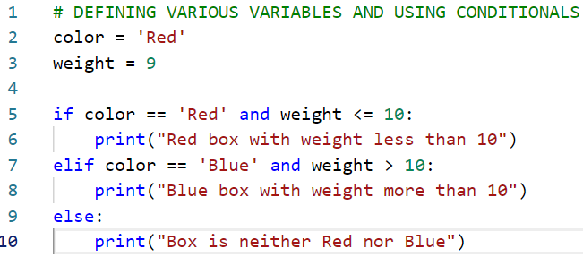
Logical conditionals in Python
In the code we are defining two variables color and weight.
Both have been assigned some values (lines 2-3).
Conditional statements have been used in lines 5-10.

Slide 9
Observations from the code
O1: We can observe that python works on indentations (no use of brackets) after if, elif and else statements.
O2: The logical operators used inside if and elif are returning Boolean (true or false) values.
O3: logical “and” actually creates a very strict condition
O3.1: Suppose we assign color value as Red but weight is assigned as 11
Then the if and elif conditions will not be executed.
Only else condition will be true in this scenario.

Slide 10
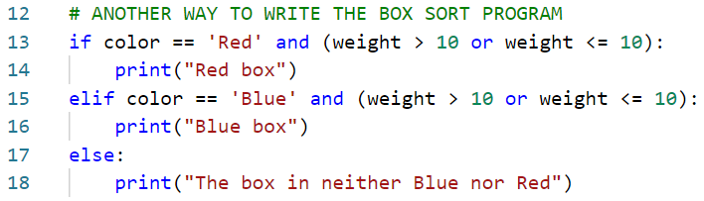
Another way to write the conditional statements
We can use the logical “or” operator.
Therefore, the if condition is true even though we entered weight greater than 10

Slide 11
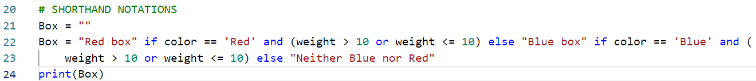
Shorthand notations for conditionals
The if, elif, else conditional statements written on the previous page can be rewritten in the following shorthand notation.
Also called as Ternary operators or conditional expressions
The main advantage of using the Ternary operator is that all the logic is written as a single line of code.
Better code manageability, maintainability and readability (though it is subjective)

Slide 12
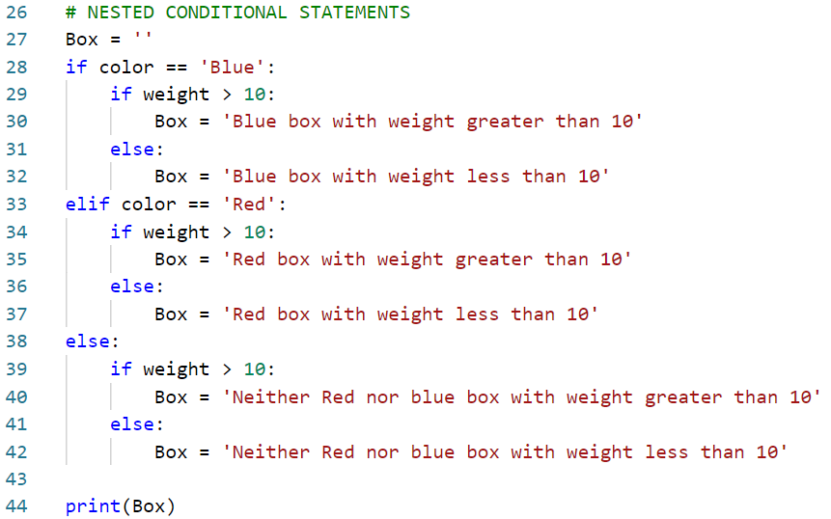
Nested conditional statements
The code in lines 27-44 demonstrates the use of nested conditional statements.
If……Else conditional statements can be embedded inside if…elif…else statements.
The code can be further enhanced by using “Ternary operators”

Slide 13
Exercise 1
The nested conditional statements shown in the previous slide can be represented by using the “Ternary operators”
Enhance the code shown in the previous slide and demonstrate the use of “Ternary operator”

Slide 14
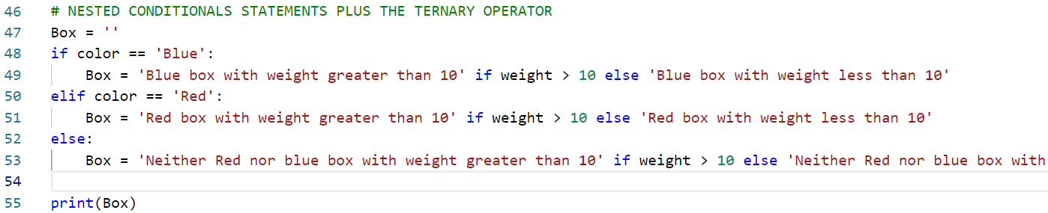
Solution 1

Slide 15
Loops

Slide 16
Loops in Python
A loop is used to iterate over a sequence
A list, a dictionary, a set, a tuple or a string
Less like a for loop in programming languages like C, C++ but
More like an iterator method found in other Object Oriented Programming languages.
We can execute a set of statements once for each item in the sequence.

Slide 17
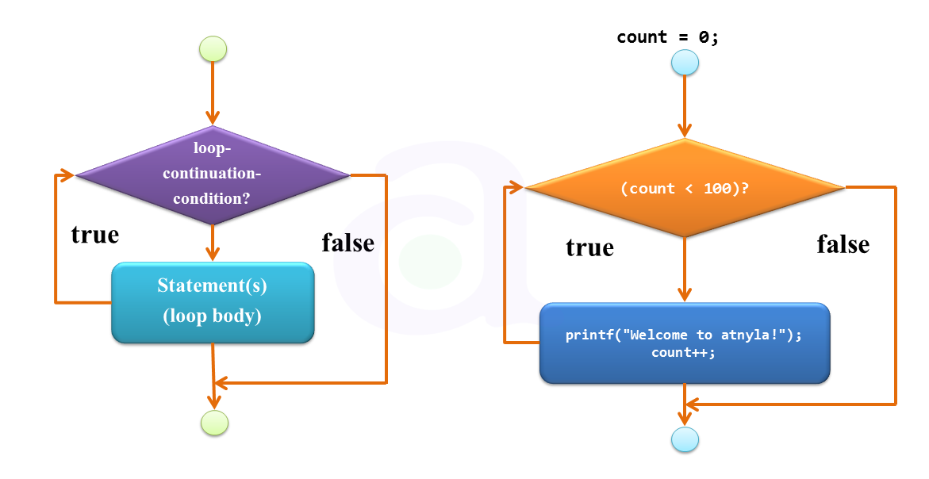
Loop examples

Slide 18
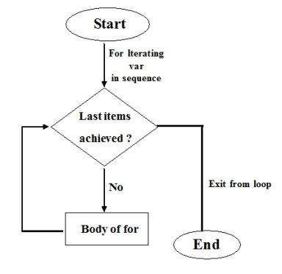
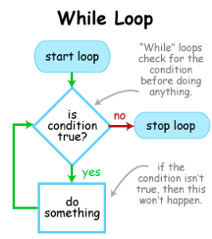
Loop examples

